Slide 1


Fish Behavior Detection
Gonçalo Adolfo
Teachers Alexandre Bernardino and H.Sofia Pinto
Instituto Superior Técnico, Universidade de Lisboa

Slide 2
Project Context
José Castelo
“Video Based Live Tracking of Fishes in Tanks”
Gonçalo Adolfo
“Fish Behavior Detection”
Behaviors detection
João Teixeira
“Focusing a subset of objects in a stream of images”
Tracking improvement
Tracking and fish classification

Slide 3
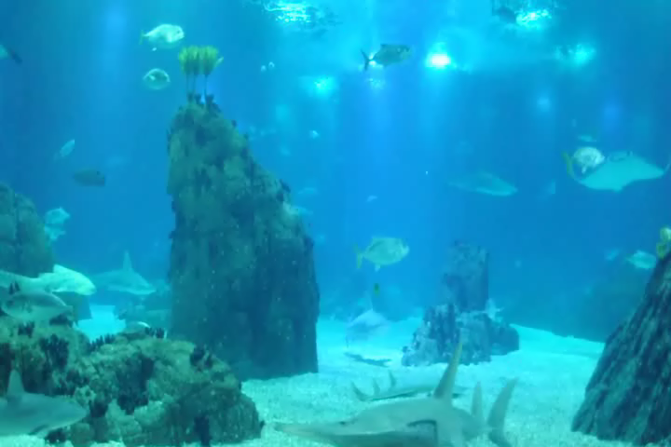

Slide 4
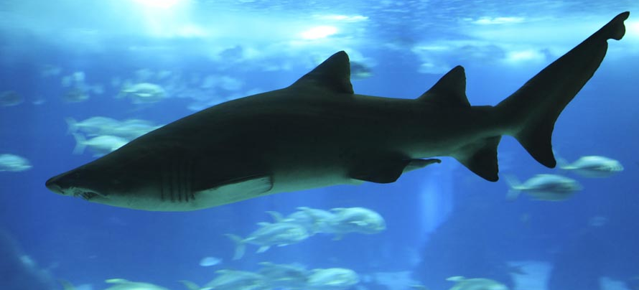
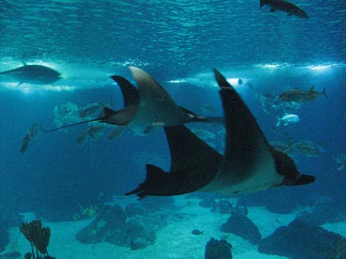
Project Ideas
Fish Detection
Tracking
Classification
Behaviors Detection
Difficult behaviors:
breath state
swallowing difficulty
Useful material: example videos in order to tune/test our algorithms
(different times of the day, different hungry levels)

Slide 5
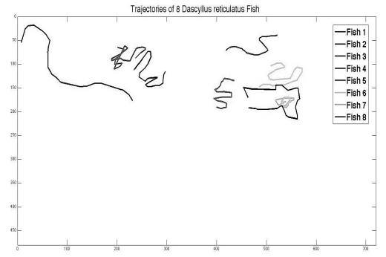
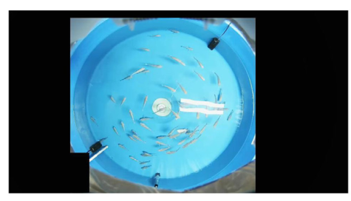
Related Work – Abnormal Behaviors
“Automatic Fish Classification for Underwater Species Behavior Understanding” (2010)
Identify fish specie based on its image
“Spatial behavioral characteristics and statistics-based kinetic energy modeling in special behaviors detection of a shoal of fish in a recirculating aquaculture system” (2016)
Detect special behaviors (not of a specific fish but of the school)
Detect anomalous behaviors

Slide 6
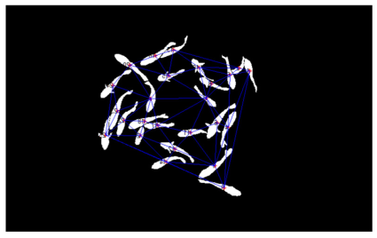
Related Work – Feeding Behavior
“Near-infrared imaging to quantify the feeding behavior of fish in aquaculture” (2017)
Detect feeding behavior
“Evaluation of fish feeding intensity in aquaculture using a convolutional neural network and machine vision” (2019)
Detect the level of hunger
Learn image features for each level based on examples
Aggregation level

Slide 7
Understanding Behaviors
Do sharks/manta rays usually have too much velocity/direction changes?
Do bull sharks usually swim near the surface of the tank?
How does the feeding process work for each of these species?
What other behaviors are useful to detect related to these species?

